Slide 1

A Profile of North American Messianic Jews
Highlights from a study
conducted by Jews for Jesus
Andrew Barron and Bev Jamison

Slide 2
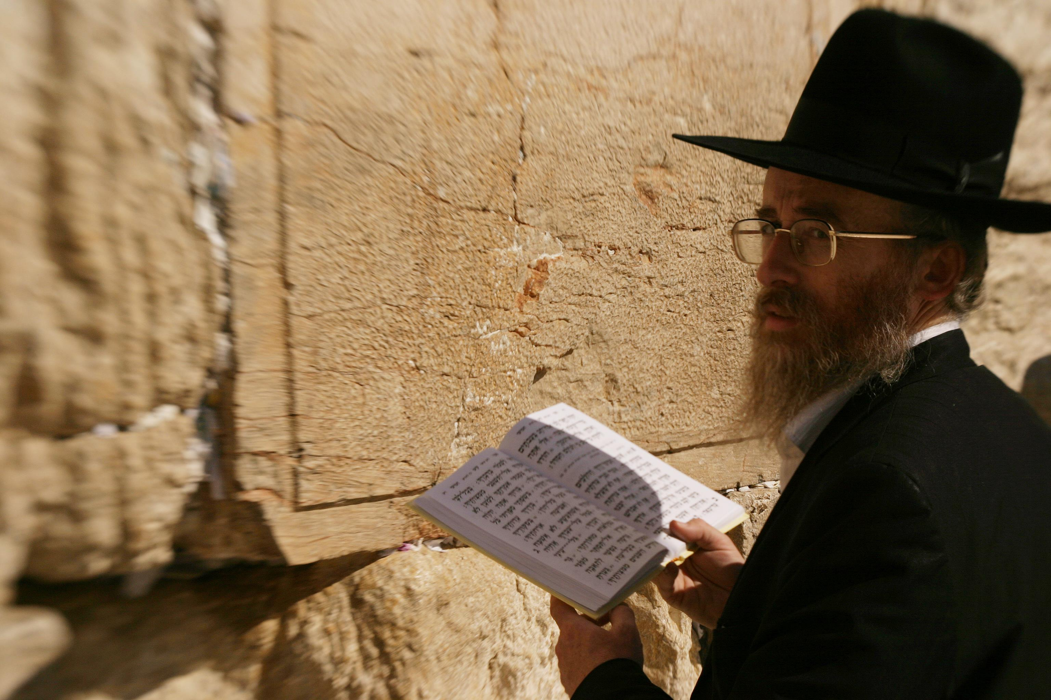
Introduction
June 1, 2013 through December 1, 2013
Follow-up to a similar study conducted in 1983.
Questions covered age, family background, education, religious observance, vocation and experiences.

Slide 3
Introduction (Cont’d)
Weakness
63% over 50 years old
  Same respondents as in 1983?
Strength
High Response rate: 15%
1,567 respondents
30% more respondents than 1983
Diversity of Questions

Slide 4
Age Range

Slide 5
Purpose
To aid those of us involved in the broader messianic community to critically evaluate our evolving movement; to provide resources and stimulate strategies for outreach, fellowship and edification.

Slide 6

Comparative Data
The statistics from this survey have been compared with a previous survey in 1983 and the 2013 Pew report on American Jews.

Slide 7
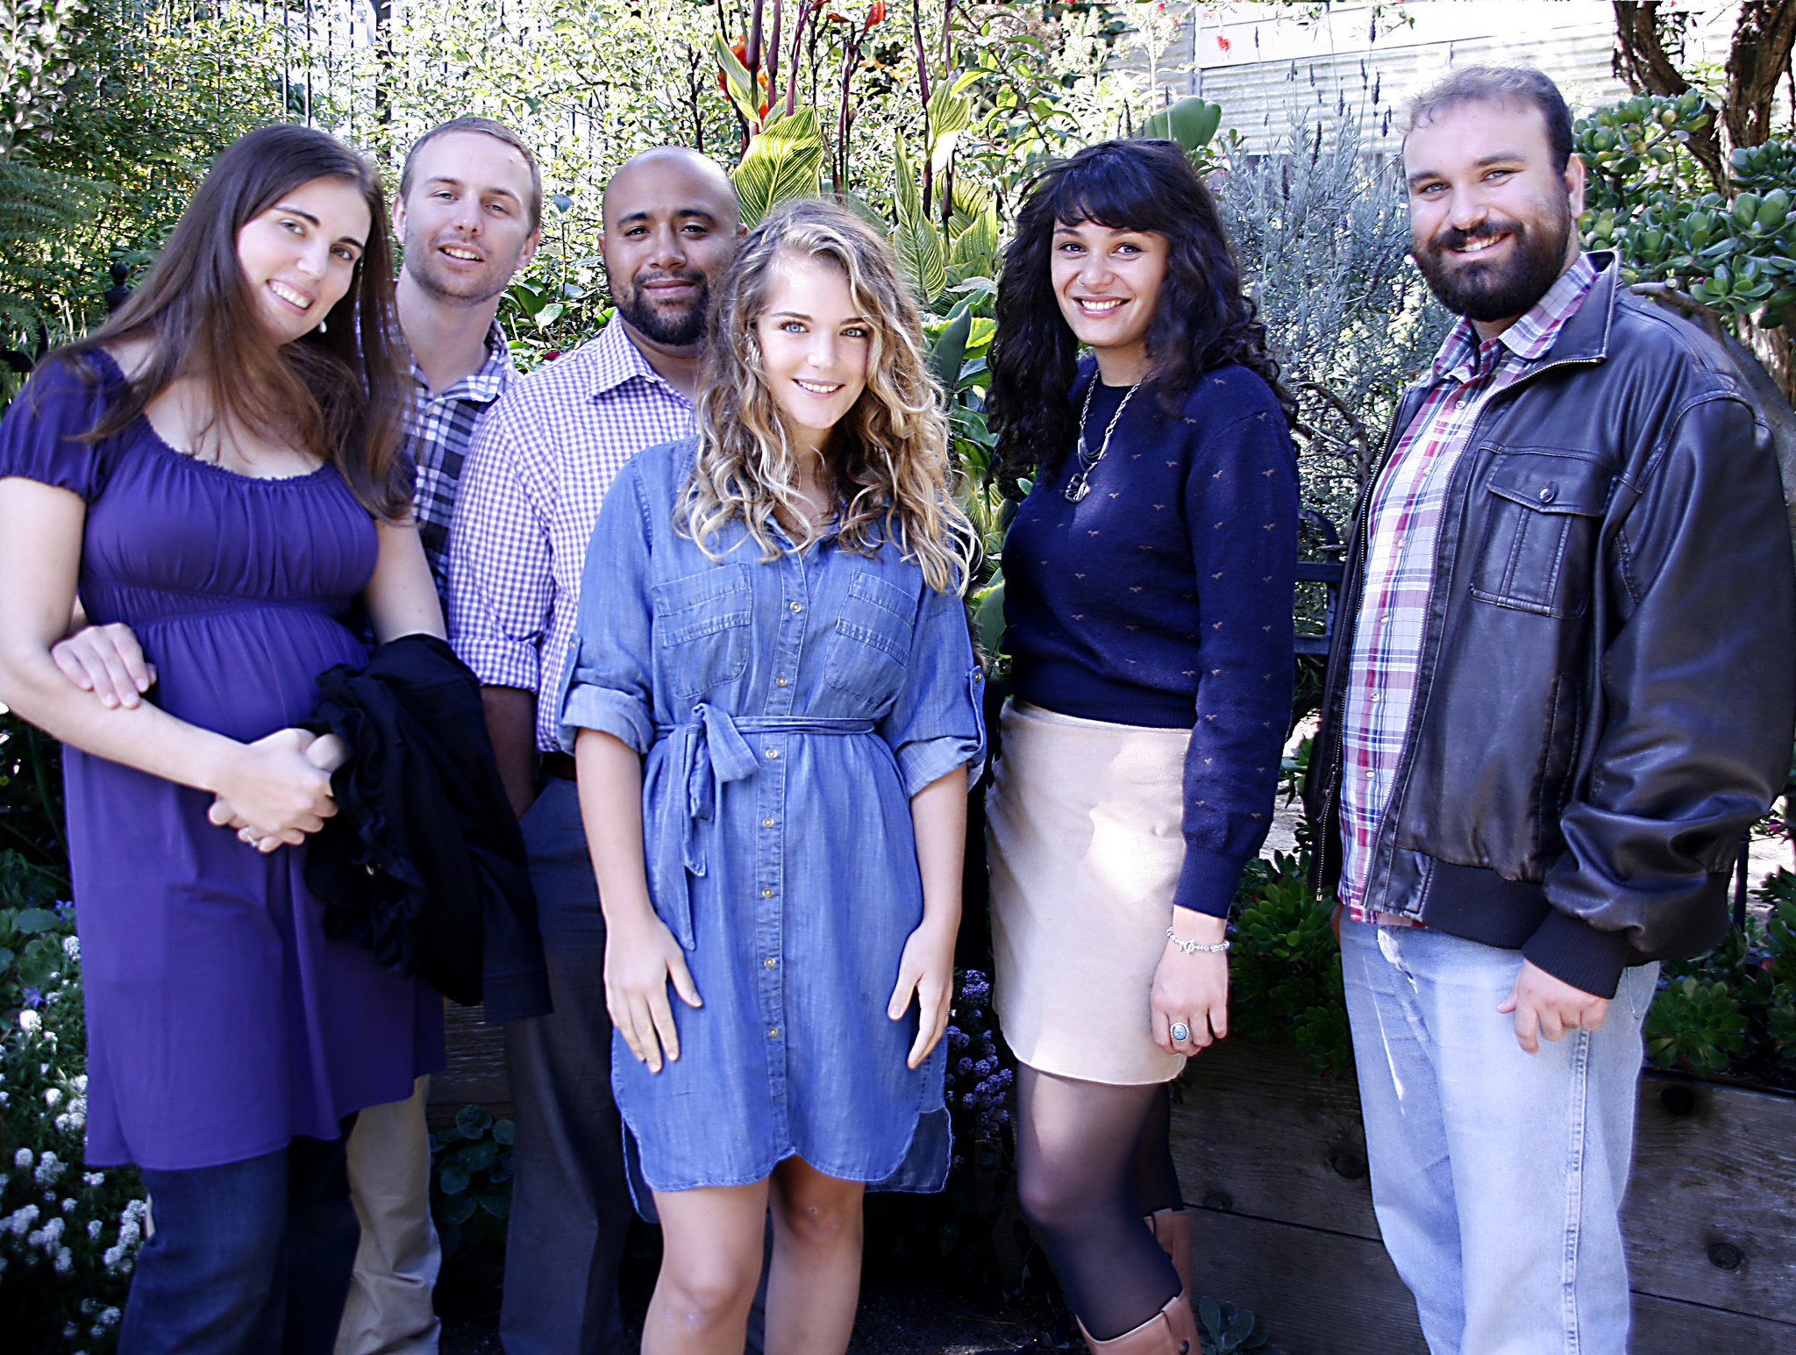
Abstract of Findings
Through all age groups most had heard the gospel by the time they were 25.
The median age for first hearing the gospel is 17 and for responding in faith is 22.

Slide 8

Abstract of Findings (Cont’d)
Lifestyles, values and identity of most of our respondents reflect efforts to maintain a connection to Jewish tradition, on the one hand, and choice, on the other.

Slide 9

Abstract of Findings (Cont’d)
The results show a broad consensus that reflects a commitment to Jewish character, culture and continuity.

Slide 10

Abstract of Findings (Cont’d)
Respondents have a wide-ranging Jewish disposition. Over 90% feel an association with Jewish tradition, observe some Jewish practices and life-cycle rituals, and mark at least some of its festivals.

Slide 11
Abstract of Findings (Cont’d)
  CS Lewis is the most well-represented author of influence across all the age groups.
  Respondents are overrepresented in education credentials and professional and specialized vocations.

Slide 12
Abstract of Findings (Cont’d)
  Jewishness and identification with the wider religious, social, and cultural characteristic of Judaism is important.
  Many want to participate in Jewish forms while still being part of the wider culture.

Slide 13
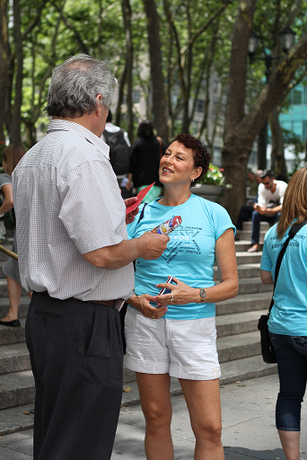
Abstract of Findings (Cont’d)
  The most common way that respondents heard the gospel was through personal conversation.
  The smallest number heard via online sources or social media; we expect that to change significantly in the future.

Slide 14

Abstract of Findings (Cont’d)
  An equal number of positive and negative responses to the gospel, with a significant number being “interested.”
  Most read the Bible after hearing the Gospel.

Slide 15

Abstract of Findings (Cont’d)
  The older group of Messianic Jews experienced quite a bit more opposition than younger respondents.

Slide 16
Family Background
Over 75% of those 50 and older reported that both parents were Jewish. But for those born after 1980 (33 years and younger), just under 33% came from households with two Jewish parents.

Slide 17
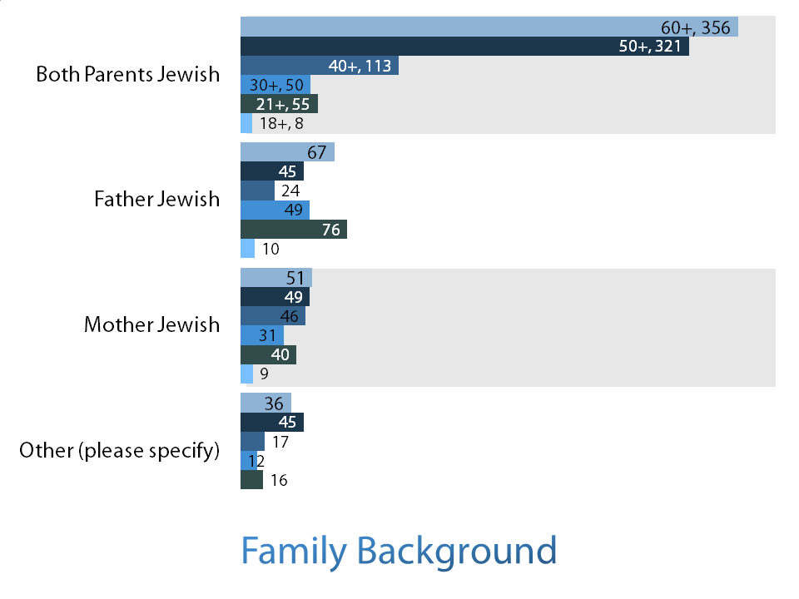
Family Background

Slide 18
Occupations:
Comparing 1983 to 2013
1983
2013

Slide 19
Occupation with General US Population

Slide 20
Education
Messianic Jews show a commitment to education that trends higher than in the general population and at par with or greater than in the wider Jewish community.
Pew 28% Post-Graduate
JB 2013 27%
General Population 10%
Pew 17% High School
JB 2013 9%
General Population 42%

Slide 21
Education
Post-Grad
Degree
BA/BS
Some College
High school
or less

Slide 22
Intermarriage
Respondents intermarried : only more so
  75%
Statistically the same to 1983
  Reform 50%
  “No denomination” 69%
Markedly higher in the 50+ age
Small change in the intermarriage trend among second generation Messianic Jews.

Slide 23
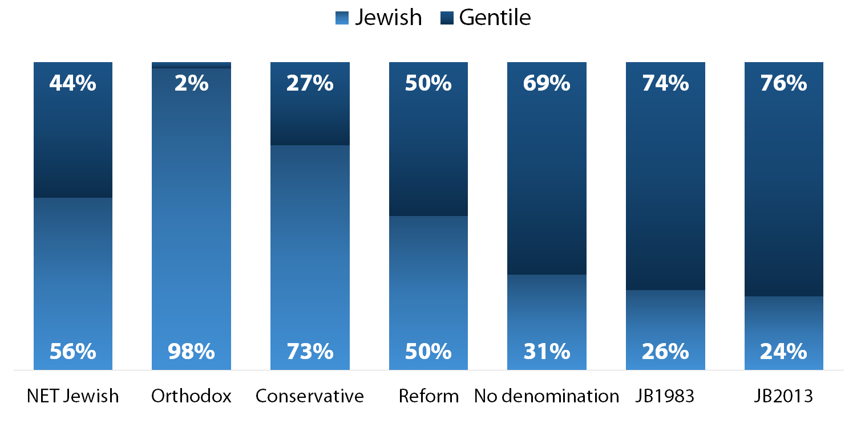
Marriage and Intermarriage

Slide 24
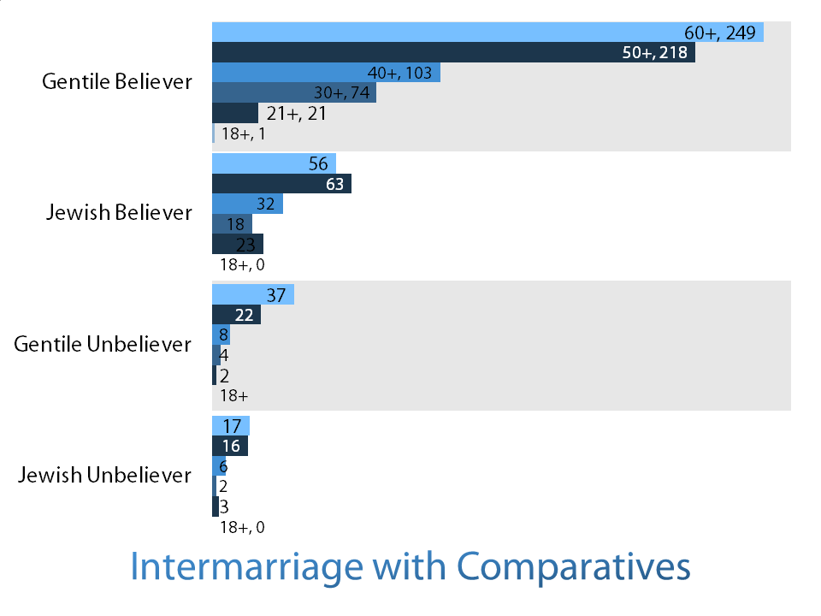
Intermarriage with Comparatives

Slide 25
Jewish Associations
These questions examined levels of interest in all things Jewish.
Respondents participate more than they did in 1983, and much more than the overall Jewish community does.
For all age groups, some kind of participation increased after coming to faith.

Slide 26
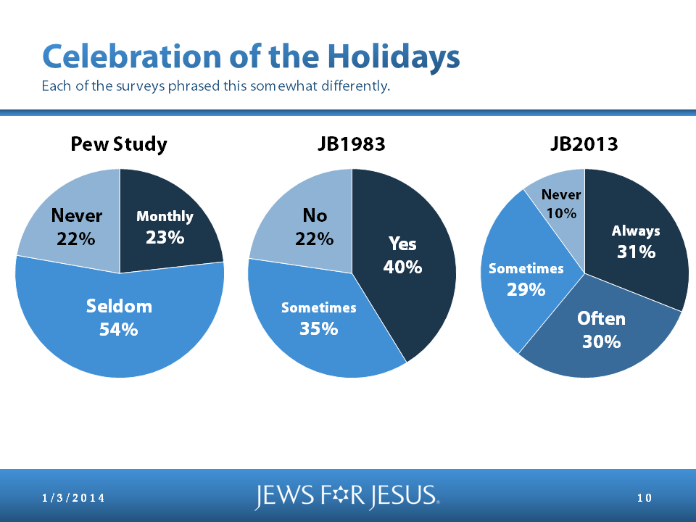
Celebration of the Holidays
1983 Study
2013 Study
Never
10%
Never
22%
Monthly
23%
No
22%
Yes
40%
Always
31%
Sometimes
29%
Seldom
54%
Sometimes
35%
Often
30%

Slide 27
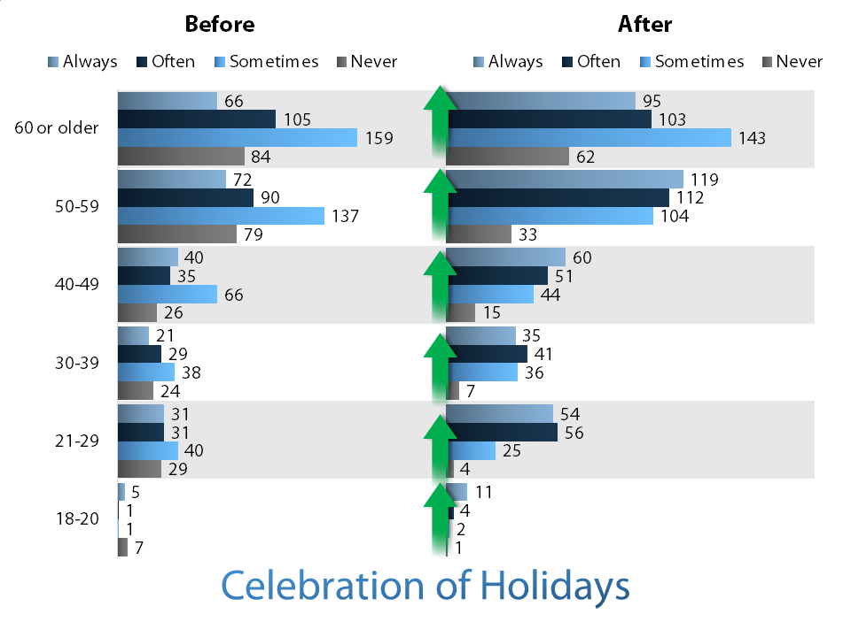
Celebration of Holidays

Slide 28
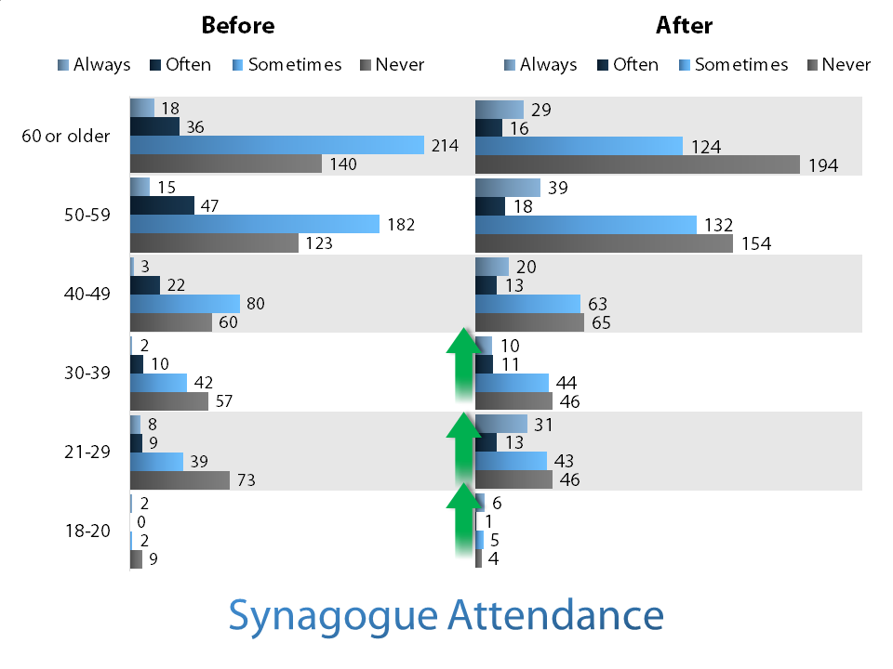
Synagogue Attendance Outside
Messianic Jewish Community

Slide 29
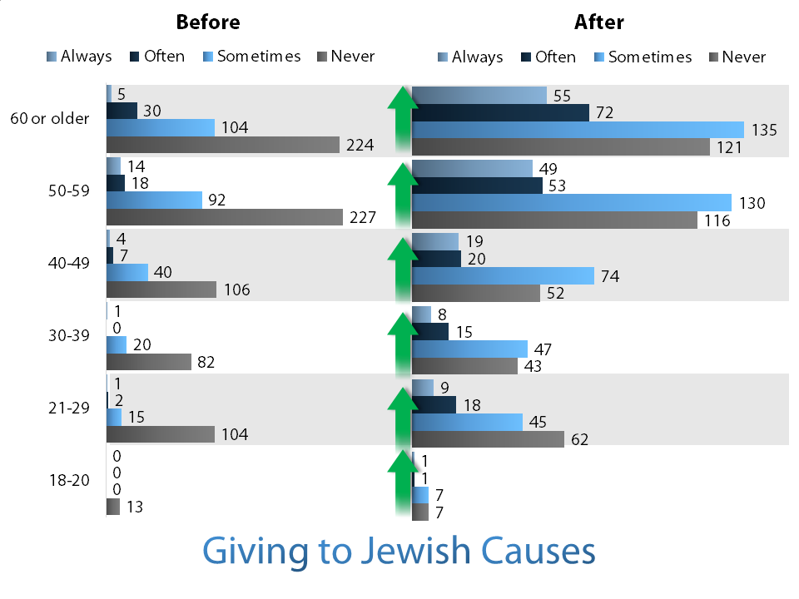
Giving to Jewish Causes

Slide 30
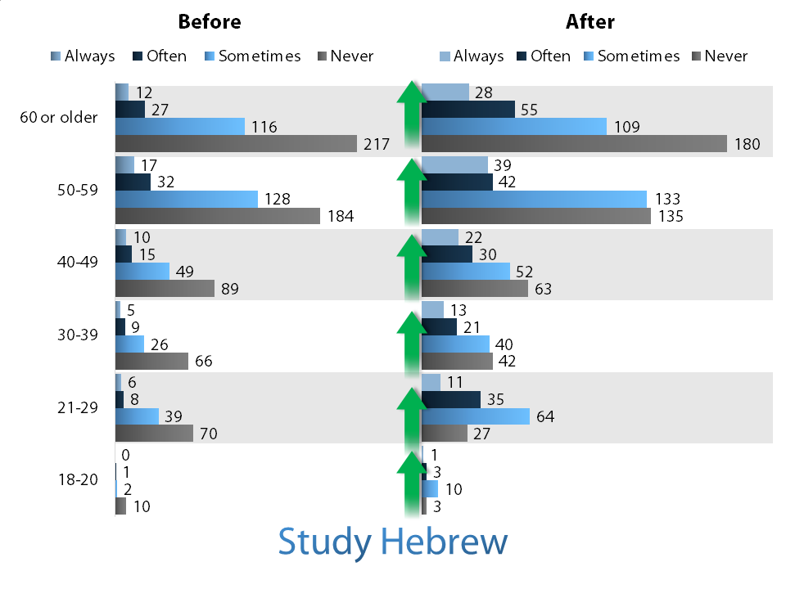
Study Hebrew

Slide 31
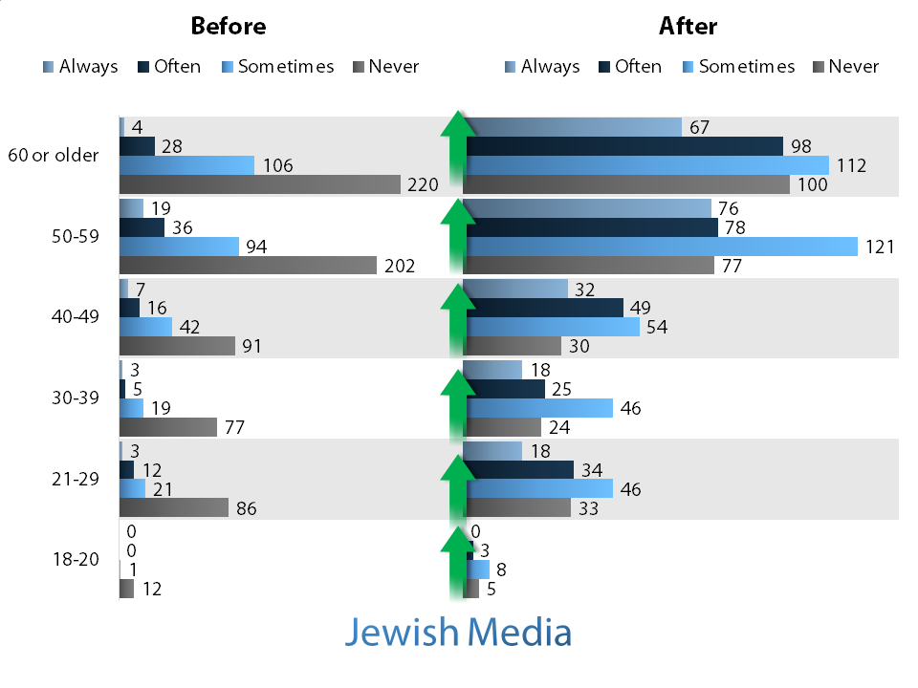
Accessing Jewish Media

Slide 32

Tikkun Olam
With regard to the Jewish value of tikkun olam (repair of the world) and without providing specifics, we see a consistent and very significant increase in orientation across age groups towards this practice. The increase here was the most notable among all the values examined.

Slide 33
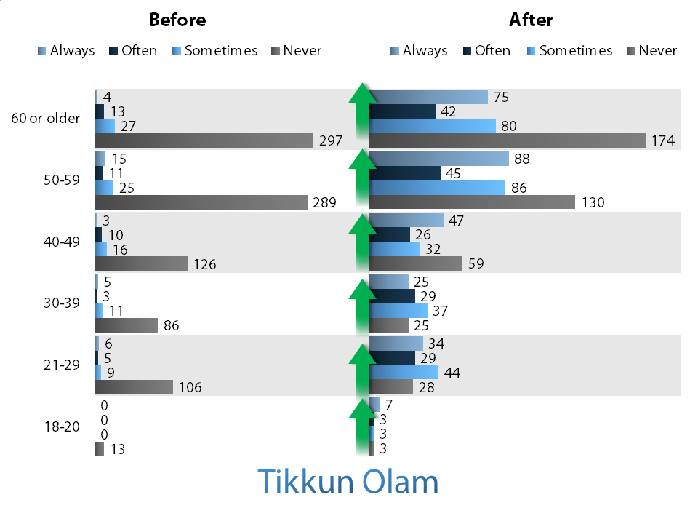
Tikkun Olam

Slide 34
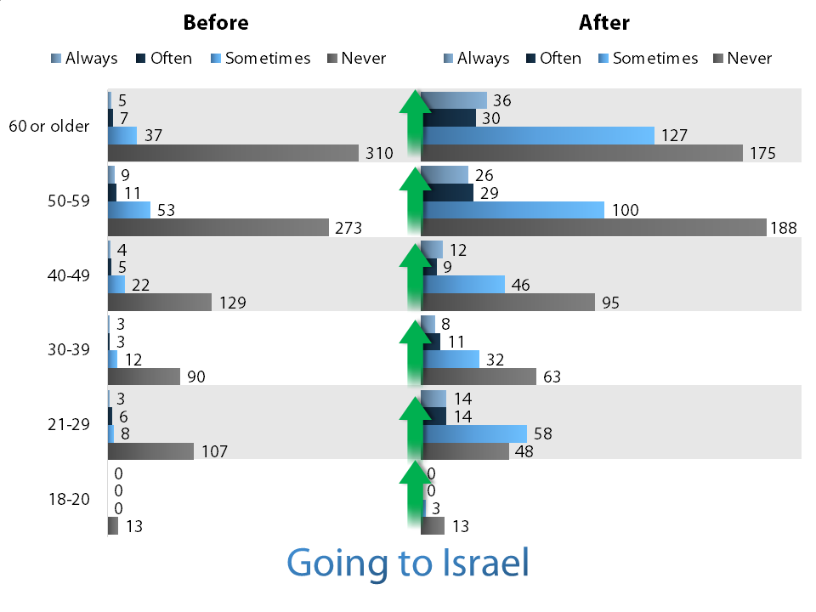
Going to Israel

Slide 35
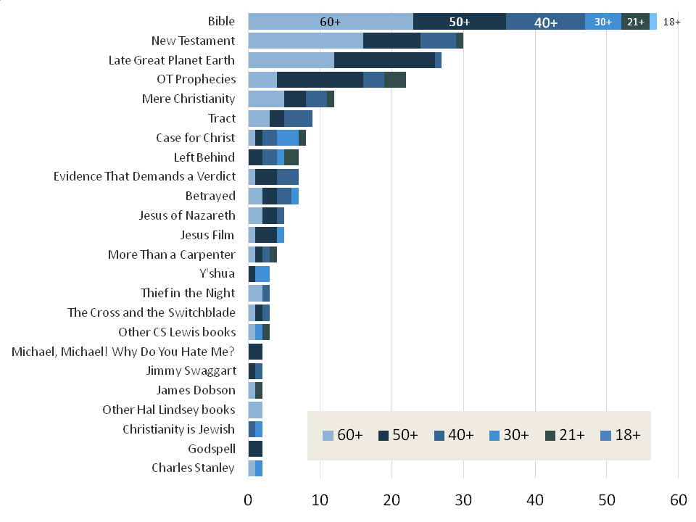
Most Influential Book or Author

Slide 36
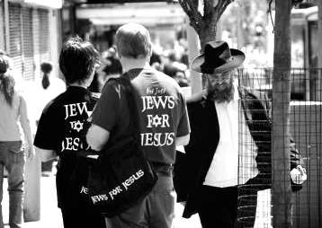
Nomenclature
There has been some significant trending in the last three decades away from Jewish believers self-identifying as “Hebrew Christians” in favor of identification as “Jewish believers” or “Messianic Jews.”

Slide 37
Nomenclature (Cont’d)
The sharpest decline since 1983 was in the use of “Hebrew Christian,” followed by a smaller decline in the self-identification of “Jewish Christian.” Interestingly, 28% are happy to identify simply as “Christian.” (Respondents could pick multiple labels.)

Slide 38
Nomenclature:
Comparing 1983 to 2013

Slide 39
First Heard the Gospel (2013)

Slide 40
Initial Attraction to The Gospel (1983)

Slide 41
Fellowship
The significantly largest number attend a “community” church – our name for non-denominational or loosely organized denominational movements.

Slide 42
Fellowship
More attend a messianic congregation than traditional (Roman Catholic, Episcopal, Methodist, Lutheran, Presbyterian), Baptist, or Charismatic congregations.
Five percent indicated attendance at both a Messianic congregation and a Christian church.

Slide 43
Fellowship (Cont’d)
A consistent pattern of Respondents in all age groups participating in and worshipping at local synagogues outside the Messianic Jewish community.

Slide 44
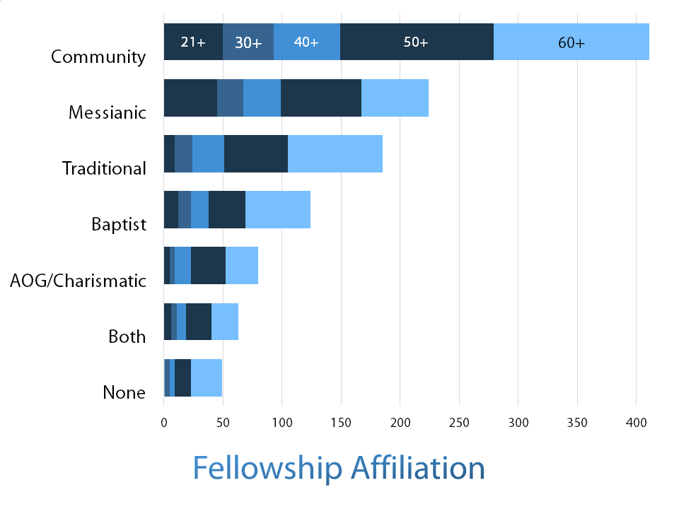
Fellowship

Slide 45
Pressure or Stress Points
Respondents were asked to characterize the pressure or stress points in their experience.
The major pressure points involved what it would mean for relationships in the Jewish community.

Slide 46
Pressure or Stress Points
Infidelity to the Jewish community was especially a point of pressure for the 50+ group.
Pressure points, especially regarding community, factored less significantly among younger generations.

Slide 47
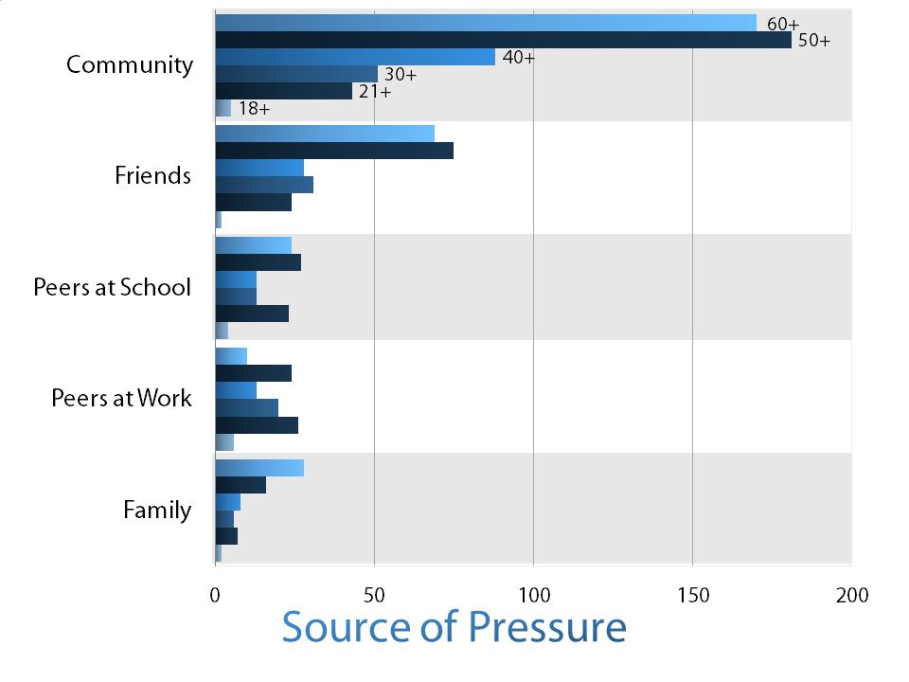
Pressure or Stress Points

Slide 48
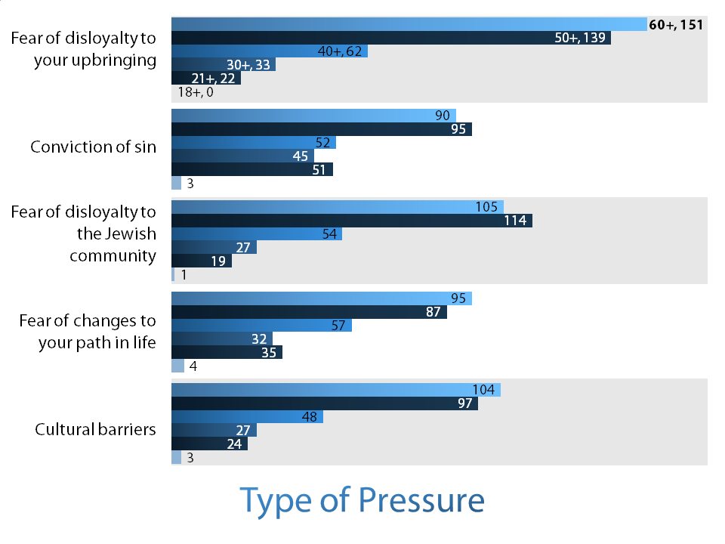
Types of Pressure

Slide 49
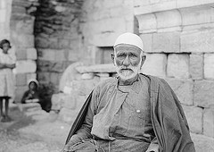
Types of Pressure
A smaller group of 24 was asked more specific questions about their experiences.
These subjects manifested:
  Social control
  Prestige
  Shame and guilt
  Hardening

Slide 50
What Is Hardening?
‘Death’
‘Loss’
‘Apathy’
‘Identity separation’
‘Tribal’
‘When I was in the synagogue I was the Christian. When I was in the Church I was the Jew.’
‘Hardening is seen in both directions.’

Slide 51

Social Control
Systems of social control break down due to secular assimilation. Most experienced passive or emotional control across age groups.

Slide 52
Social Control
Of the 24 in the group:
  2 were disowned
  2 experienced religious control
  3 lost job opportunities
  3 were uninvited to family/community events
  5 experienced psychological control - “You cause us pain. You are hurting your grandparents. You will not be able to marry a Jew. You are a Gentile.”

Slide 53
Social Control
I graphed these experiences with respect to age and ‘levels’ of pressure or ‘hardening’.

Slide 54
Shame and Guilt

Slide 55
Identity

Slide 56
Prestige

Slide 57
Conclusions
Respondents are highly assimilated (socially integrated) but relatively less acculturated (acquired resources of a different culture) and accommodated (employing another tradition in self expression)n acculturation and accommodation
They find truth that is consistent and coherent with the Scripture. They do not find this same coherence in their culture. The often feel like strangers.

Slide 58
Conclusion (Cont’d)
Messianic Jewish community in North America is more similar to the American Jewish community than to the general US population in demographics such as Jewish dispositions, education and occupation.

Slide 59

Conclusion (Cont’d)
The nomenclature preference and religious observance levels among these Messianic Jews indicate a continuing identification with the Jewish people.
The more recent study also indicated that churches and Messianic congregations have a significant impact.

Slide 60
Conclusion (Cont’d)
The need for critical thinking in the area of intermarriage.
The Messianic Jewish community, congregations and ministries are making new and dynamic efforts to provide fellowship and service opportunities to young Messianic Jews which alter intermarriage patterns. We see this in our intermarriage statistics.

Slide 61
Conclusion (Cont’d)
Responses to the questions about how respondents first heard the gospel and what attracted them to the gospel underline the significance of individual interaction.
The older group experienced quite a bit more external pressure than younger respondents.

Slide 62

Conclusion (Cont’d)
Intermarriage, having only one Jewish parent and attendance at a church, rather than a Messianic congregation, did not appear to decrease Jewish identity or even Jewish practices.

Slide 63
Conclusion (Cont’d)
This suggests continuing the ongoing conversation as to what extent we need to prophetically challenge and yet seek to remain a part of the Jewish community at large.

Slide 64
Missiological Issues
We need to build relationships, make the Bible available, recognize and then address the pressure points.
Are we all open to challenge and be challenged by the status quo?
Are our publications and platforms relevant and do they communicate to our audience?

Slide 65
Missiological Questions (Cont’d)
Is our material relevant to the group receiving the message rather than those bringing it?
Are we talking to Jewish people?
Do we have the courage to face opposition?
Do we have the ability to communicate with regard to a sophisticated culture group?
  education
  world experience

Slide 66
Missiological Issues (Cont’d)
Increased influence of churches and messianic congregations.
Are we willing to exercise critical judgment regarding material, methods and projects used – “Do they work now?” Can we measure?

Slide 67
Action Points
Improve the quality of the Survey
Ask New Questions
Survey South America, Europe, Asia Middle East and Australia

Slide 68
Final Word
David Baron:
“What we continually press upon Jews is that we believe Jesus is the Son of Man and Son of God, not in spite of, but because we are Jews. We believe that Jesus is the King of our people, the sum and substance of our Scripture, the fulfiller of our law and Prophets, the embodiment of the promises of our covenant. Our Testimony is that of Jews to Jews.”
(1893)

Slide 69
More Information
Full Results Available:
  Online @ www.j4j.com/2014jfjsurvey
  For Published booklet email: andrew.barron@jewsforjesus.ca
  Slides Available
  Hard Copies at the back

Slide 70
Bibliography
Institute, Guttman Center of the Israel Democracy. "A Portrait of Israeli Jewry." Jerusalem, 2000.
Jesus, Jews for. Jewish Believer Survey. San Francisco: Jews for Jesus, 1983.
Pew Research, Religion and Public Life Project. "A Portrait of Jewish Americans" October 1, 2013.
United States Census Bureau, American Fact Finder, Report DP03, "Selected Economic Characteristics, 2012 American Community Survey 1-Year Estimates".

Slide 71
Authors
Andrew Barron, MA, is the director of Jews for Jesus Canada and is presently a D Min student at Wycliffe College University of Toronto.
Beverly Jamison, PhD, holds a BSc in Mathematics and a PhD in Computer Science. She has served as a reviewer in mathematics, statistics, and technology in the healthcare sector and presently works in Information Technology and Academic Publishing.

